Slide 1
Randomized Algorithms CS648
Lecture 26
Probabilistic methods - II

Slide 2
problem 4 Sum free subset of large size

Slide 3


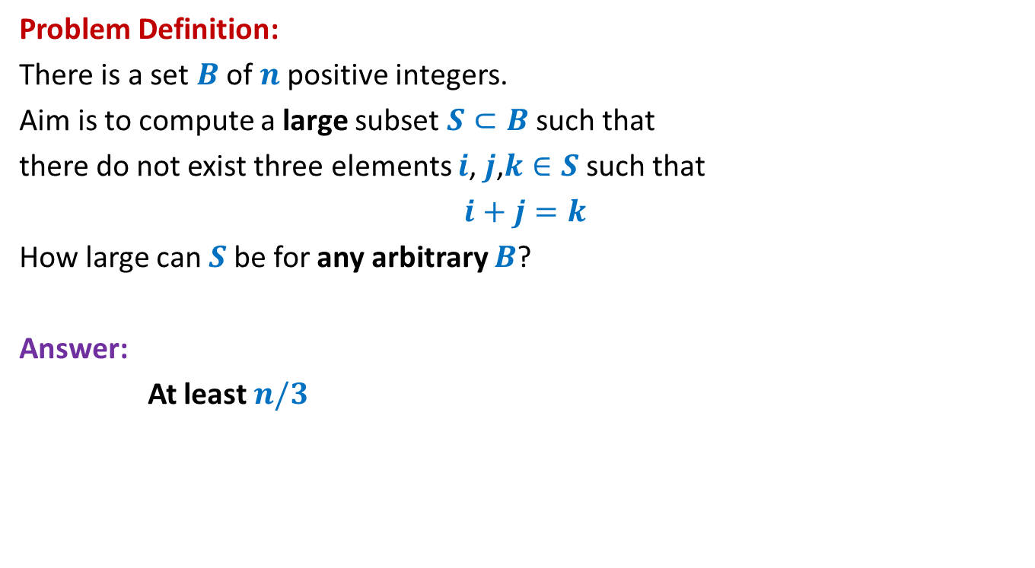



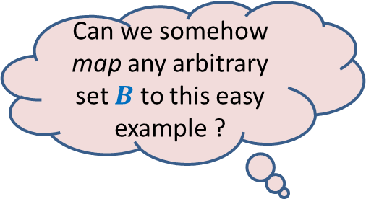
Large subset that is sum-free
Can we somehow map any arbitrary set $B$ to this easy example ?
Problem Definition:
There is a set $B$of $n$positive integers.
Aim is to compute a large subset $S⊂B$such that
there do not exist three elements $i$, $j$,$k∈S$ such that
$i+j=k$
How large can $S$be for any arbitrary $B$?
Answer:
At least $n/3$
Yes, by randomization
An easy example of $B$
Suppose $B=[1..n]$
$$n=3m$$
$m m+1$ … … $2m+1$
$1 2$ … … $3m$
$$S$$

Slide 4
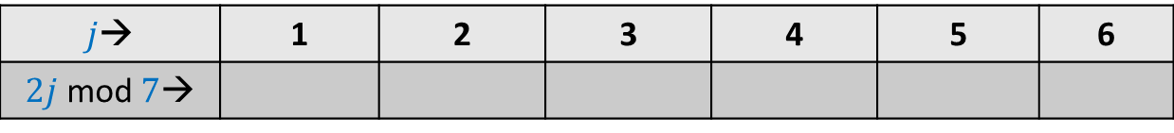

mod operation
$p$ : a prime number
$A$: {$1,2,…,p−1$}
Consider any $i∈A$.
Question: What can we say about set $A_{i}$ = { $ij mod p | j∈A$} ?
Example: $p=7$
$j$→ | 1 | 2 | 3 | 4 | 5 | 6
$2j$ mod $7$→
2
4
6
1
3
5

Slide 5
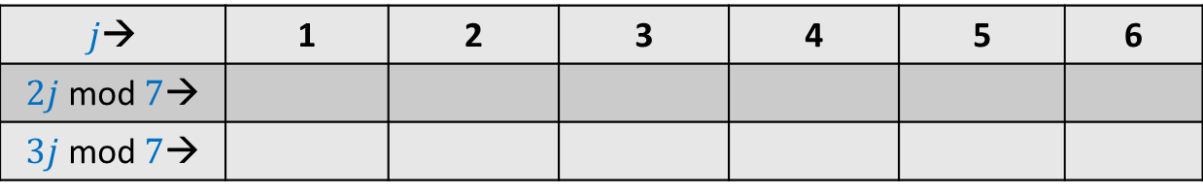
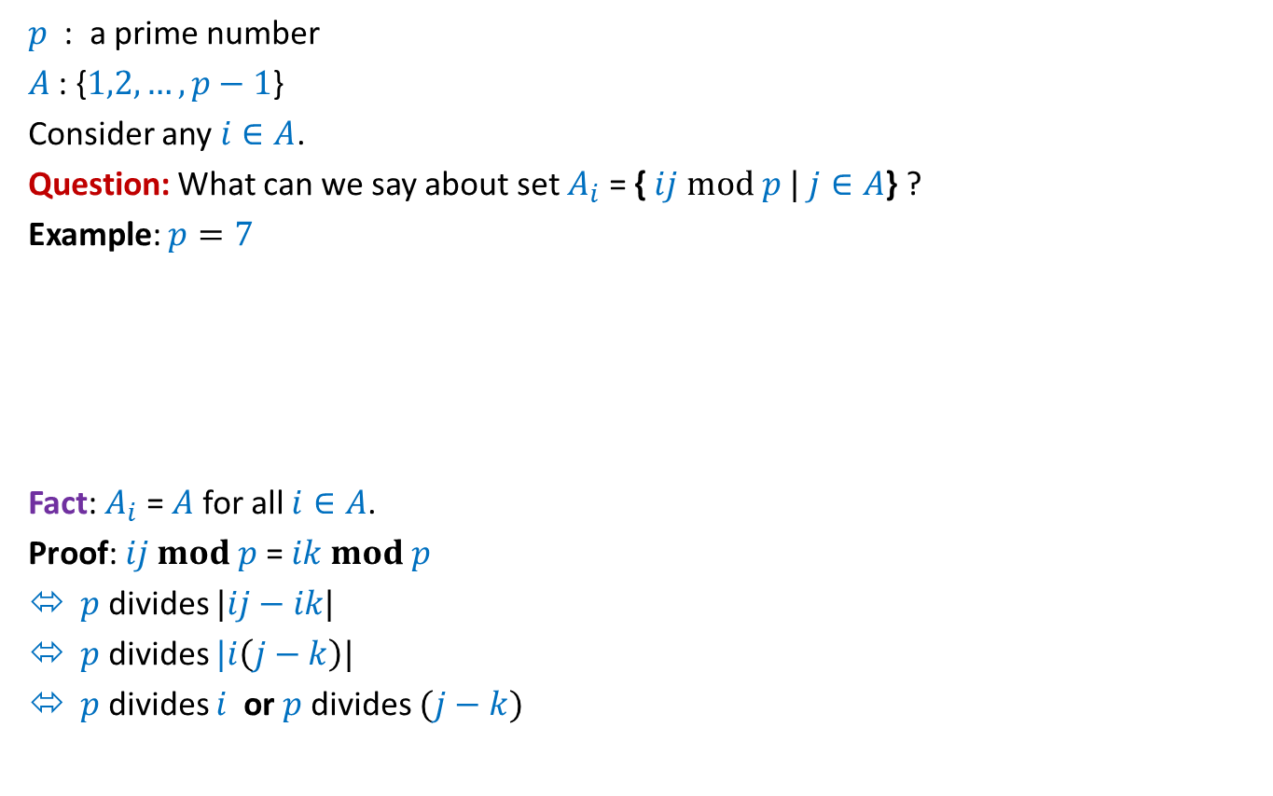
mod operation
$p$ : a prime number
$A$: {$1,2,…,p−1$}
Consider any $i∈A$.
Question: What can we say about set $A_{i}$ = { $ij mod p |$ $j∈A$} ?
Example: $p=7$
Fact: $A_{i}$ = $A$ for all $i∈A$.
Proof: $ij mod p$= $ik mod p$
$p$ divides $|ij−ik|$
$p$ divides $|i\left(j−k\right)|$
$p$ divides $i$ or $p$divides $(j−k)$
$j$→ | 1 | 2 | 3 | 4 | 5 | 6
$2j$ mod $7$→
$3j$ mod $7$→
2
4
6
1
3
5
3 6 2 5 1 4
Not possible

Slide 6


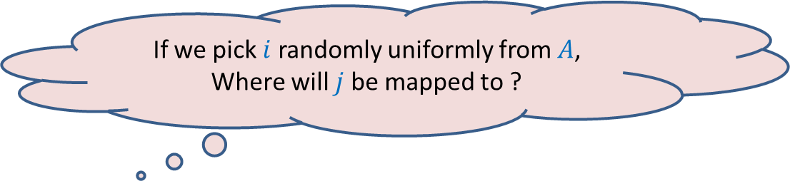
mod operation
$p$ : a prime number
$A$: {$1,2,…,p−1$}
Consider any $i∈A$.
Question: What can we say about set $A_{i}$ = { $ij mod p |$ $j∈A$} ?
Example: $p=7$
$j$→ | 1 | 2 | 3 | 4 | 5 | 6
$2j$ mod $7$→
$3j$ mod $7$→
2
4
6
1
3
5
3 6 2 5 1 4
If we pick $i$ randomly uniformly from $A$,
Where will $j$ be mapped to ?
Uniformly over whole of $A$.

Slide 7
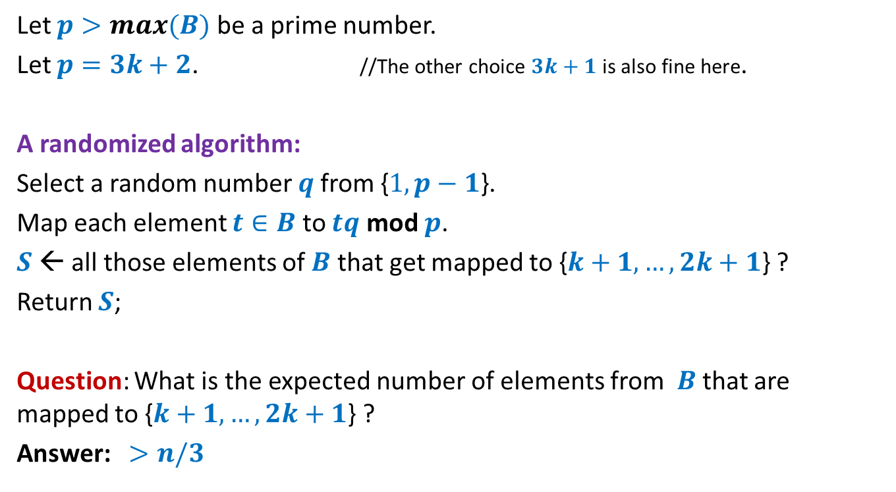
Large subset that is sum-free
Let $p>max(B)$ be a prime number.
Let $p=3k+2$. //The other choice $3k+1$ is also fine here.
A randomized algorithm:
Select a random number $q$from {$1,p−1$}.
Map each element $t∈B$ to $tq$ mod $p$.
$S$← all those elements of $B$ that get mapped to {$k+1,…,2k+1$} ?
Return $S$;
Question: What is the expected number of elements from $B$that are mapped to {$k+1,…,2k+1$} ?
Answer: $>n/3$
To prove it, use
the fact that mapping is 1-1 and uniform.
and Linearity of expectation.

Slide 8

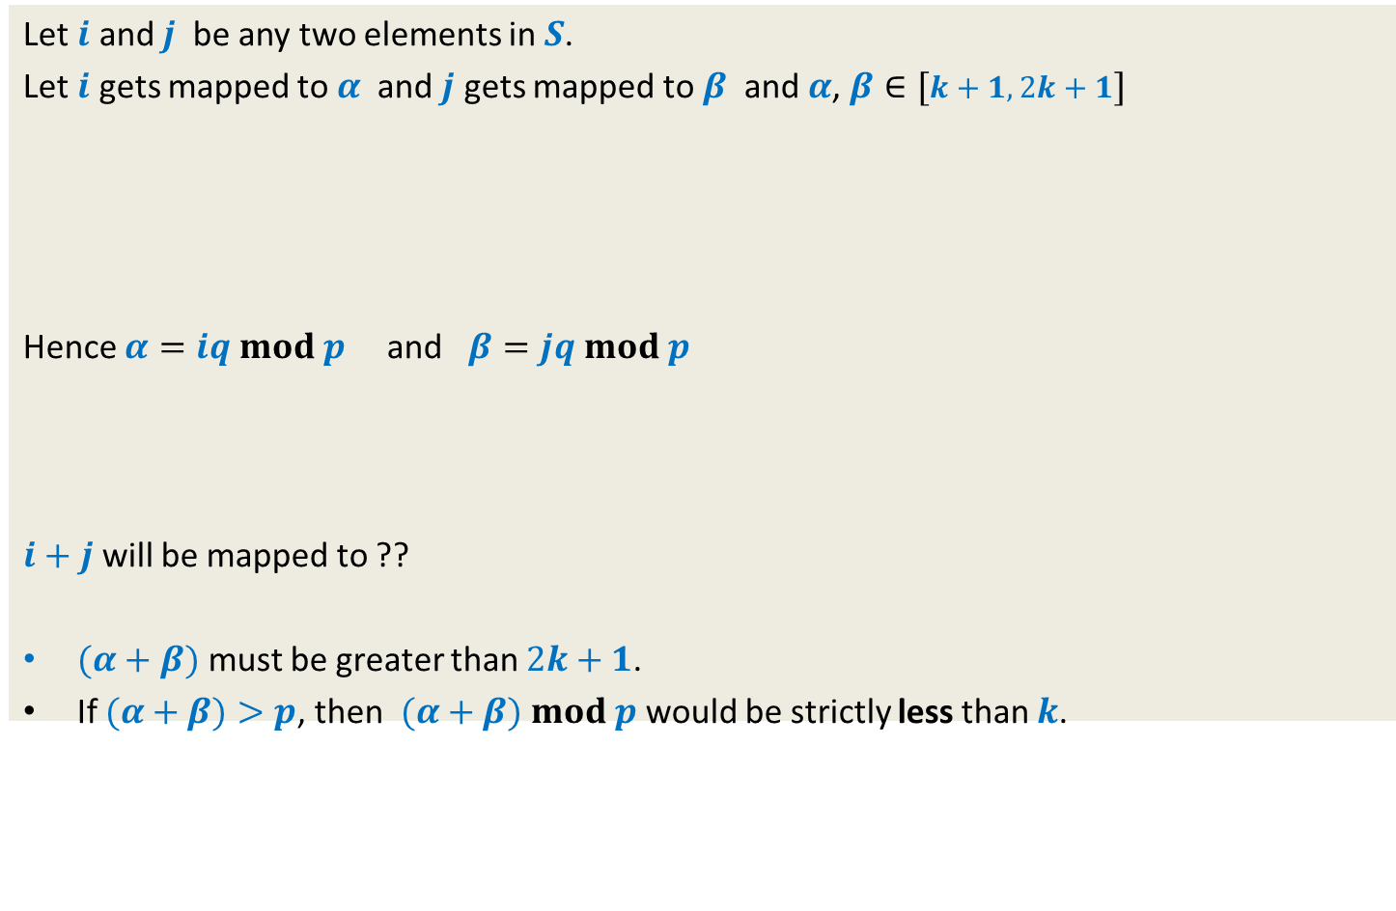


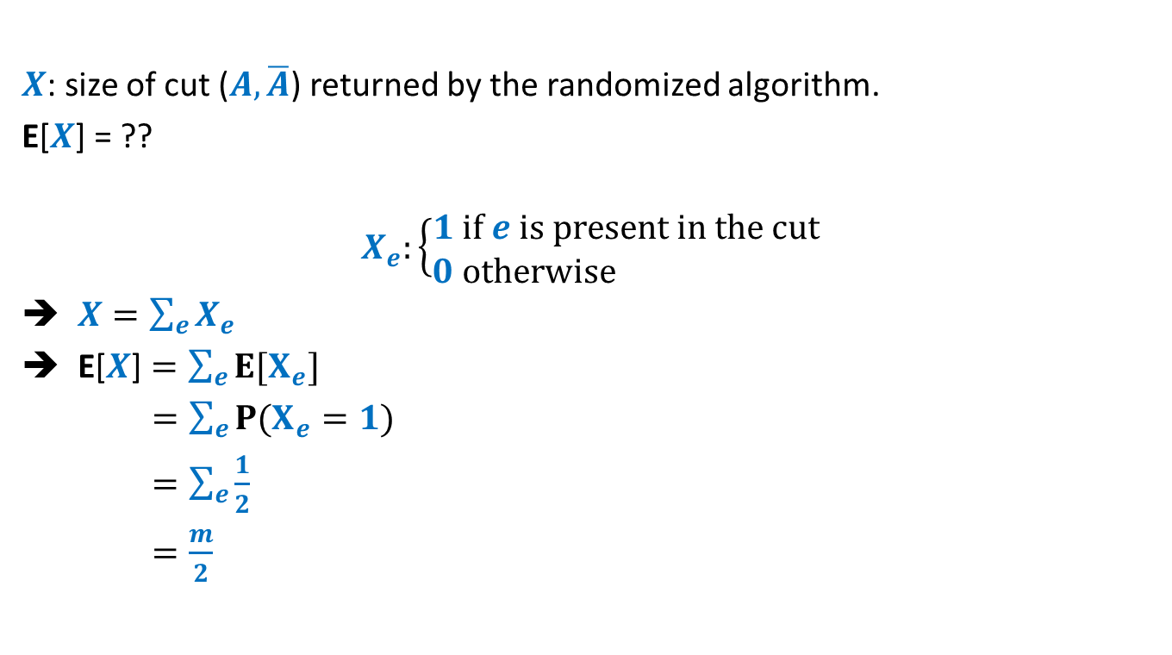





Showing that $S$is sum-free.
Let $i$ and $j$ be any two elements in $S$.
Let $i$ gets mapped to $α$ and $j$ gets mapped to $β$ and $α$, $β∈[k+1,2k+1]$
Hence $α=iq mod p$ and $β=jq mod p$
$i+j$ will be mapped to ??
$(α+β)$ must be greater than $2k+1$.
If $(α+β)>p$, then $(α+β)$ $mod p$ would be strictly less than $k$.
1 2 … $k$ $k+1$ … … … $2k+1$ … $3k+1$
$$α$$
$$β$$
$$\left(iqmod p+jqmod p\right)$$
$mod p$
$(α+β)$ $mod p$
$\left(i+j\right)q$ $mod p$
$\left(iq+jq\right)$ $mod p$
Because even for the largest two elements - $2k$ , $2k+1$ in the middle half,
their sum mod $p$ is $k−1$

Slide 9
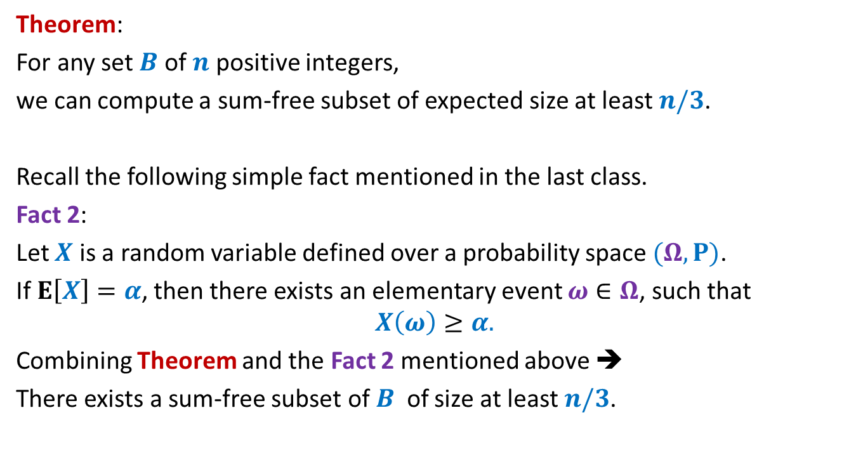
Large subset that is sum-free
Theorem:
For any set $B$ of $n$ positive integers,
we can compute a sum-free subset of expected size at least $n/3$.
Recall the following simple fact mentioned in the last class.
Fact 2:
Let $X$ is a random variable defined over a probability space $(Ω,P)$.
If $E\left[X\right]=α$, then there exists an elementary event $ω∈Ω$, such that
$$X\left(ω\right)≥α.$$
Combining Theorem and the Fact 2 mentioned above ➔
There exists a sum-free subset of $B$ of size at least $n/3$.

Slide 10

Try to ponder over the entire solution given for the Large sum-free subset problem.
Try to realize the importance of each part of the solution
primality of $p$,
the choice of middle third,
…

Slide 11
3-SAT Problem

Slide 12
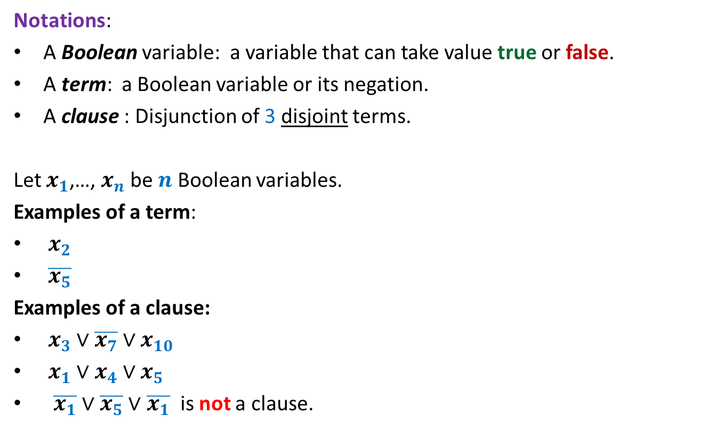
3-SAT Problem
Notations:
A Boolean variable: a variable that can take value true or false.
A term: a Boolean variable or its negation.
A clause : Disjunction of 3 disjoint terms.
Let $x_{1}$,…, $x_{n}$ be $n$ Boolean variables.
Examples of a term:
$x_{2}$
$\overline{x_{5}}$
Examples of a clause:
$x_{3}∨\overline{x_{7}}∨x_{10}$
$x_{1}∨x_{4}∨x_{5}$
$\overline{x_{1}}∨$ $\overline{x_{5}}∨$ $\overline{x_{1}}$ is not a clause.

Slide 13
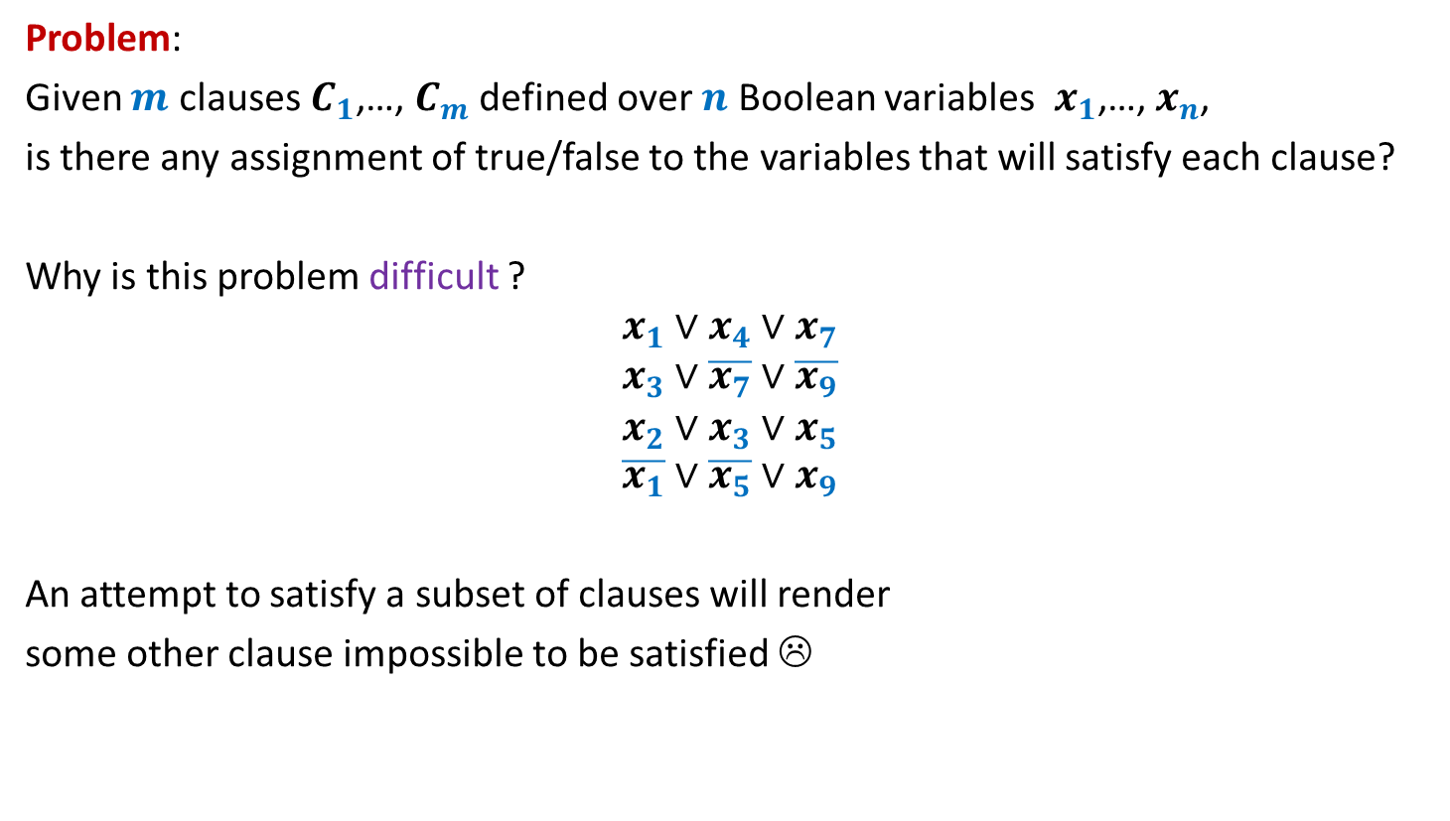
3-SAT Problem
Problem:
Given $m$ clauses $C_{1}$,…, $C_{m}$ defined over $n$ Boolean variables $x_{1}$,…, $x_{n}$,
is there any assignment of true/false to the variables that will satisfy each clause?
Why is this problem difficult ?
$$x_{1}∨x_{4}∨x_{7}$$
$$x_{3}∨\overline{x_{7}}∨\overline{x_{9}}$$
$$x_{2}∨x_{3}∨x_{5}$$
$$\overline{x_{1}}∨\overline{x_{5}}∨x_{9}$$
An attempt to satisfy a subset of clauses will render
some other clause impossible to be satisfied ☹

Slide 14
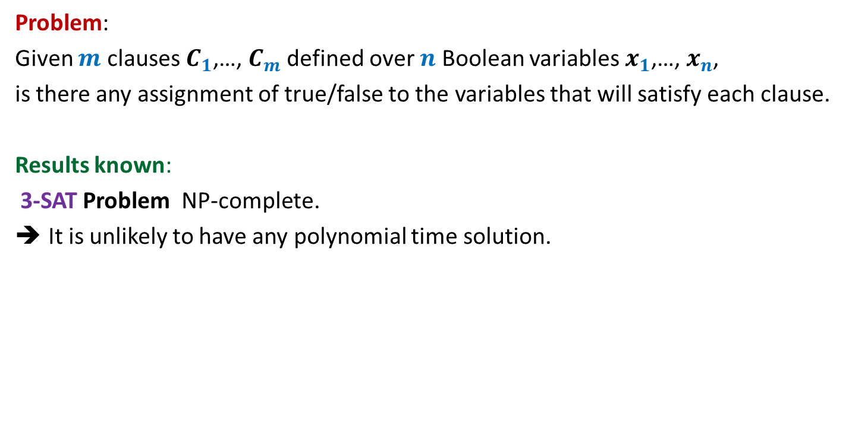
3-SAT Problem
Problem:
Given $m$ clauses $C_{1}$,…, $C_{m}$ defined over $n$ Boolean variables $x_{1}$,…, $x_{n}$,
is there any assignment of true/false to the variables that will satisfy each clause.
Results known:
3-SAT Problem NP-complete.
It is unlikely to have any polynomial time solution.

Slide 15
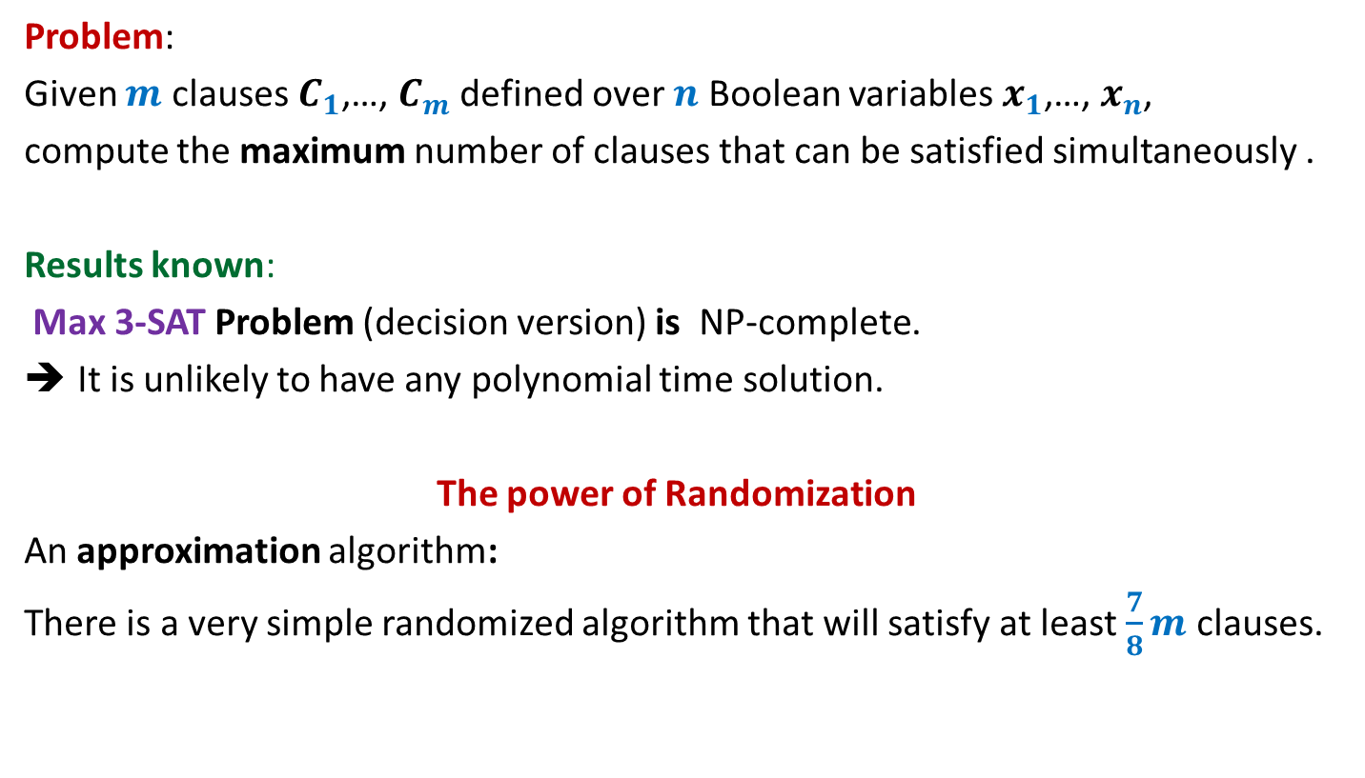
Max 3-SAT Problem
Problem:
Given $m$ clauses $C_{1}$,…, $C_{m}$ defined over $n$ Boolean variables $x_{1}$,…, $x_{n}$,
compute the maximum number of clauses that can be satisfied simultaneously .
Results known:
Max 3-SAT Problem (decision version) is NP-complete.
It is unlikely to have any polynomial time solution.
The power of Randomization
An approximation algorithm:
There is a very simple randomized algorithm that will satisfy at least $\frac{7}{8}m$ clauses.

Slide 16
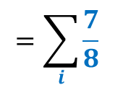
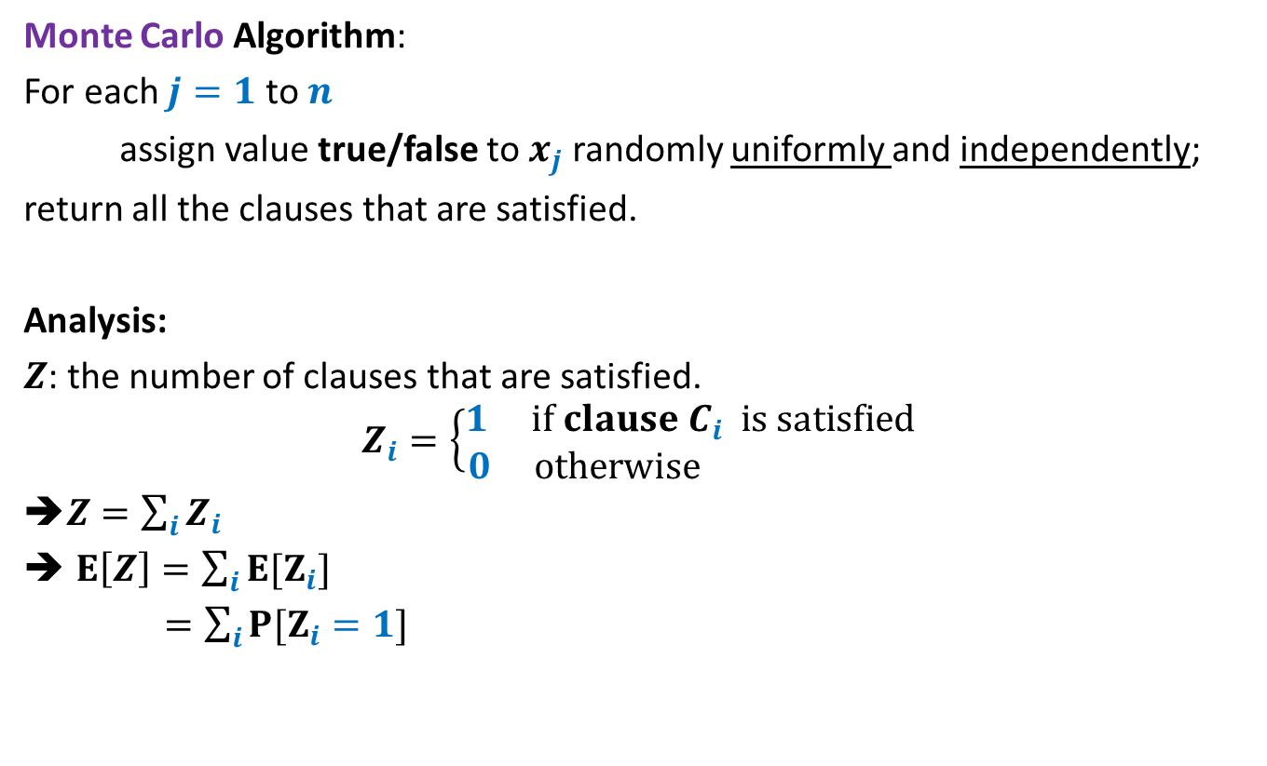

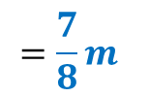
Max 3-SAT Problem
Monte Carlo Algorithm:
For each $j=1$ to $n$
assign value true/false to $x_{j}$ randomly uniformly and independently;
return all the clauses that are satisfied.
Analysis:
$Z$: the number of clauses that are satisfied.
$$Z_{i}=\left\{\begin{aligned}1 if clause C_{i} is satisfied \\ 0 otherwise \end{aligned}\right.$$
➔$Z=\sum_{i}{Z_{i}}$
$E\left[Z\right]=\sum_{i}{{E[Z}_{i}]}$
$=\sum_{i}{{P[Z}_{i}=1]}$
$$=\sum_{i}{\frac{7}{8}}$$
$$=\frac{7}{8}m$$
$$\overline{x_{1}}∨\overline{x_{5}}∨x_{9}$$

Slide 17
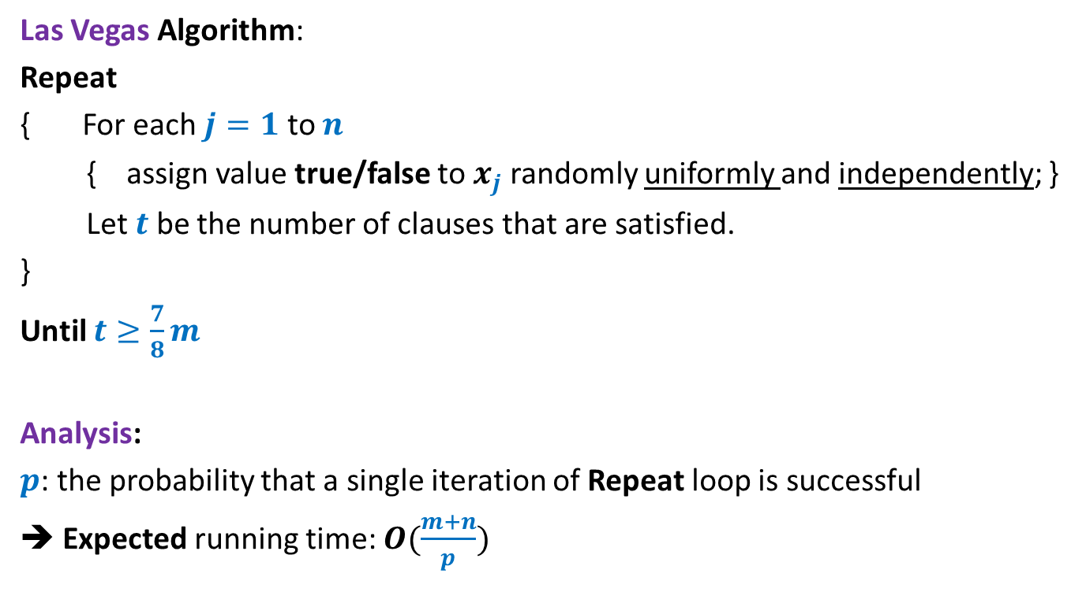
Max 3-SAT Problem
Las Vegas Algorithm:
Repeat
{ For each $j=1$ to $n$
{ assign value true/false to $x_{j}$ randomly uniformly and independently; }
Let $t$ be the number of clauses that are satisfied.
}
Until $t≥\frac{7}{8}m$
Analysis:
$p$: the probability that a single iteration of Repeat loop is successful
➔ Expected running time: $O(\frac{m+n}{p})$

Slide 18
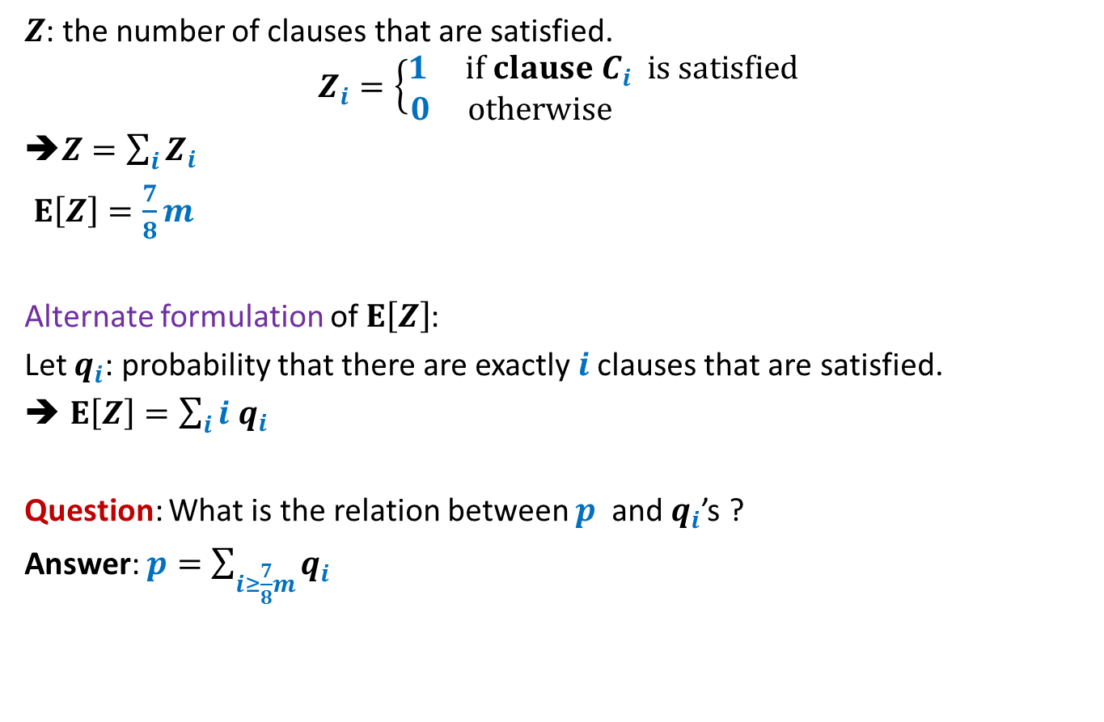
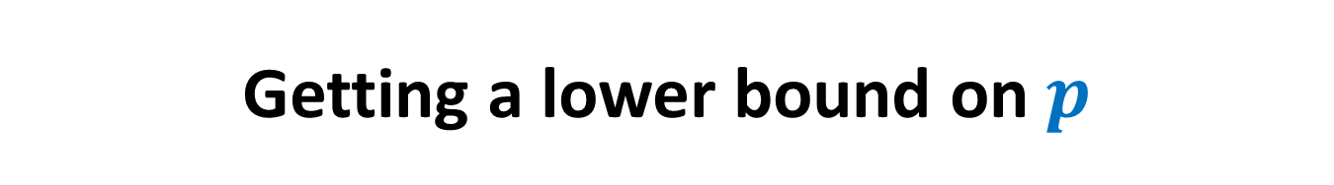
Getting a lower bound on $p$
$Z$: the number of clauses that are satisfied.
$$Z_{i}=\left\{\begin{aligned}1 if clause C_{i} is satisfied \\ 0 otherwise \end{aligned}\right.$$
➔$Z=\sum_{i}{Z_{i}}$
$E\left[Z\right]=\frac{7}{8}m$
Alternate formulation of $E\left[Z\right]$:
Let $q_{i}$: probability that there are exactly $i$clauses that are satisfied.
$E\left[Z\right]=\sum_{i}{i q_{i}}$
Question: What is the relation between $p$ and $q_{i}$’s ?
Answer: $p=\sum_{i≥\frac{7}{8}m}{q_{i}}$

Slide 19
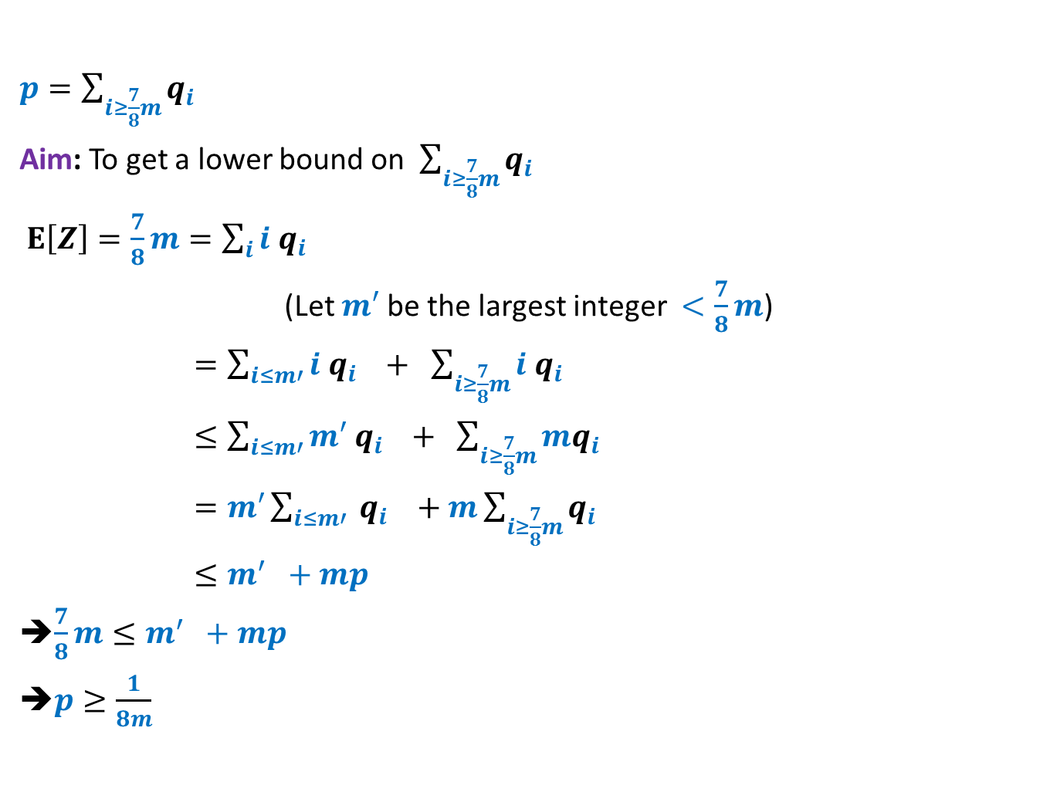

Getting a lower bound on $p$
$p=\sum_{i≥\frac{7}{8}m}{q_{i}}$
Aim: To get a lower bound on $\sum_{i≥\frac{7}{8}m}{q_{i}}$
$E\left[Z\right]=\frac{7}{8}m=\sum_{i}{i q_{i}}$
(Let $m′$ be the largest integer $<\frac{7}{8}m$)
$=\sum_{i≤m′}{i q_{i}} + \sum_{i≥\frac{7}{8}m}{i q_{i}}$
$≤\sum_{i≤m′}{m′ q_{i}} + \sum_{i≥\frac{7}{8}m}{mq_{i}}$
$=m′\sum_{i≤m′}{ q_{i}} +m\sum_{i≥\frac{7}{8}m}{q_{i}}$
$≤m^{′} +mp$
➔$\frac{7}{8}m≤m^{′} +mp$
➔$p≥\frac{1}{8m}$
Express $m$as $8k+t$ where$0≤t<8$.
So $\frac{7}{8}m=7k+7t/8$.
If $t=0$then $\frac{7}{8}m−m′$ is 1.
For all other cases, $\frac{7}{8}m−m′$ is a fraction with denominator $2,4, or 8$. So $\frac{7}{8}m−m≥1/8$
➔ $p≥\frac{\frac{7}{8}m−m′}{m}$

Slide 20

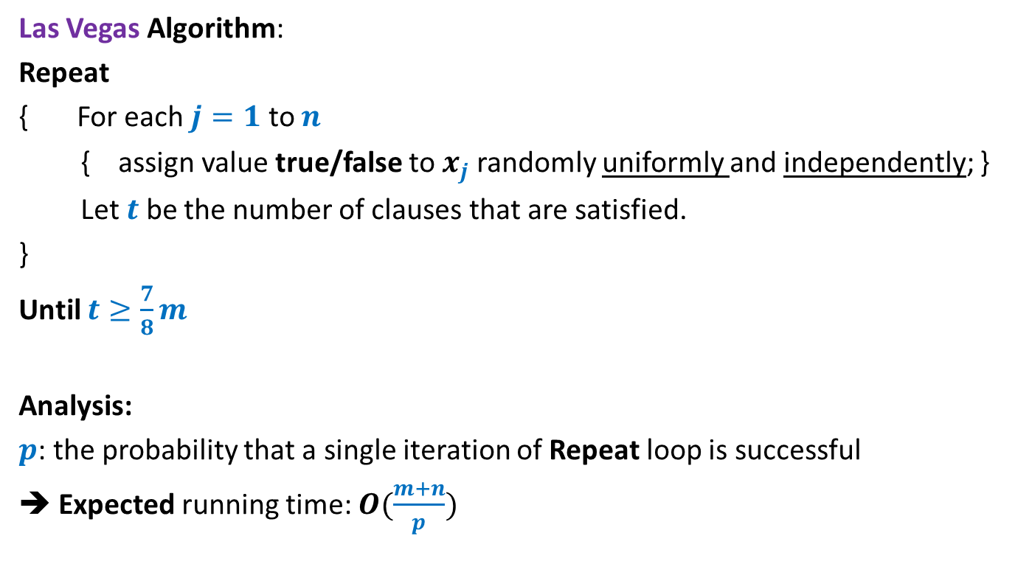
Max 3-SAT Problem
Las Vegas Algorithm:
Repeat
{ For each $j=1$ to $n$
{ assign value true/false to $x_{j}$ randomly uniformly and independently; }
Let $t$ be the number of clauses that are satisfied.
}
Until $t≥\frac{7}{8}m$
Analysis:
$p$: the probability that a single iteration of Repeat loop is successful
➔ Expected running time: $O(\frac{m+n}{p})$
$$=O({\left(m+n\right)}^{2})$$

Slide 21
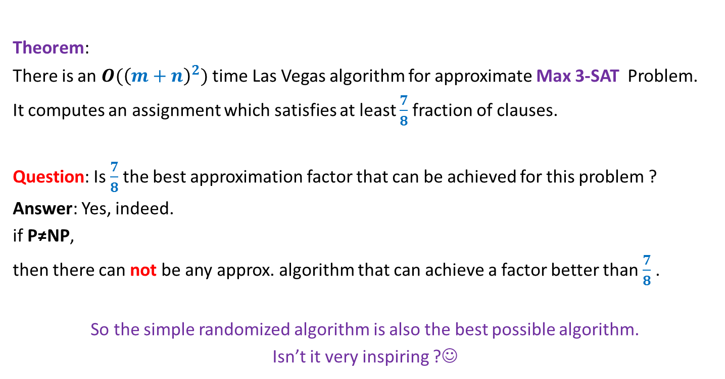
Max 3-SAT Problem
Theorem:
There is an $O({\left(m+n\right)}^{2})$ time Las Vegas algorithm for approximate Max 3-SAT Problem.
It computes an assignment which satisfies at least $\frac{7}{8}$fraction of clauses.
Question: Is $\frac{7}{8}$the best approximation factor that can be achieved for this problem ?
Answer: Yes, indeed.
if P≠NP,
then there can not be any approx. algorithm that can achieve a factor better than $\frac{7}{8}$ .
So the simple randomized algorithm is also the best possible algorithm.
Isn’t it very inspiring ?☺

Slide 22
Probabilistic Method: Alteration

Slide 23
An interesting problem in Combinatorial Geometry

Slide 24

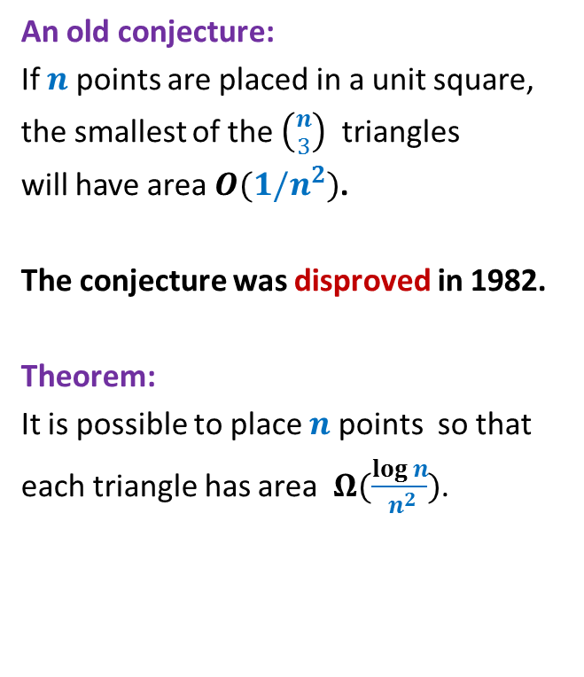
$$1$$
An old conjecture:
If $n$ points are placed in a unit square,
the smallest of the $\left({n \atop 3}\right)$ triangles
will have area $O(1/n^{2})$.
The conjecture was disproved in 1982.
Theorem:
It is possible to place $n$ points so that
each triangle has area $Ω(\frac{log n}{ n^{2}})$.

Slide 25
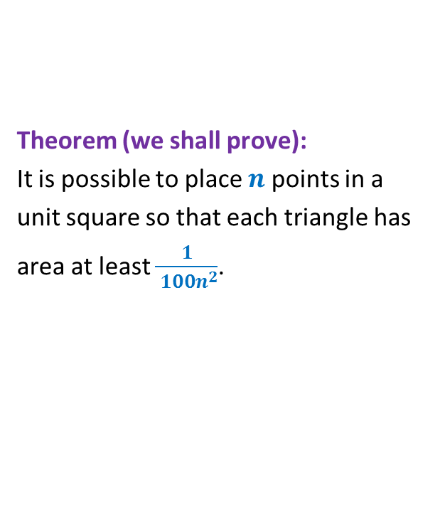
$$1$$
Theorem (we shall prove):
It is possible to place $n$ points in a
unit square so that each triangle has
area at least $\frac{1}{ {100n}^{2}}$.

Slide 26
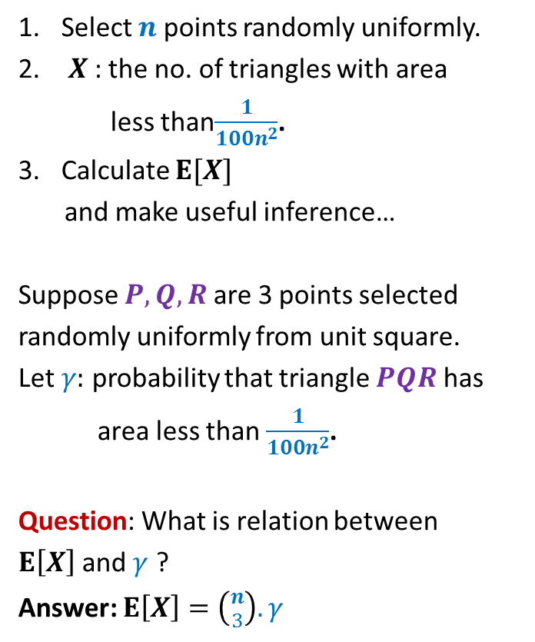
$$1$$
Select $n$ points randomly uniformly.
$X$: the no. of triangles with area
less than$\frac{1}{100n^{2}}$.
Calculate $E[X]$
and make useful inference…
Suppose $P,Q,R$ are 3 points selected
randomly uniformly from unit square.
Let $γ:$ probability that triangle $PQR$ has
area less than $\frac{1}{100n^{2}}$.
Question: What is relation between
$E\left[X\right]$ and $γ$ ?
Answer: $E\left[X\right]=\left({n \atop 3}\right). γ$

Slide 27
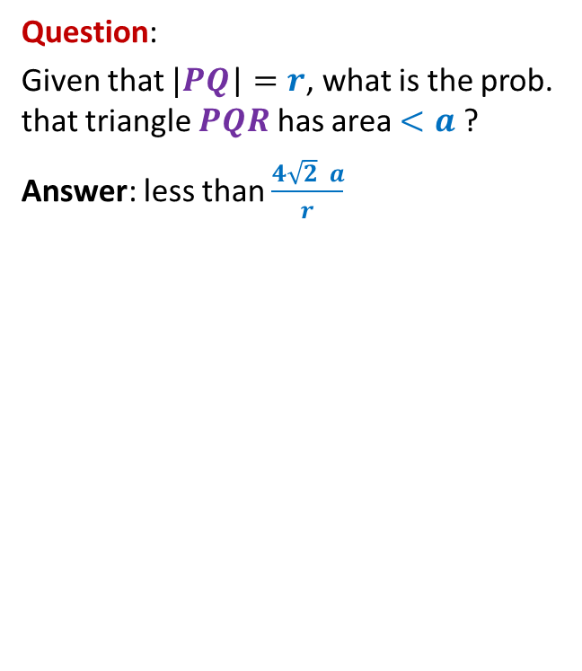
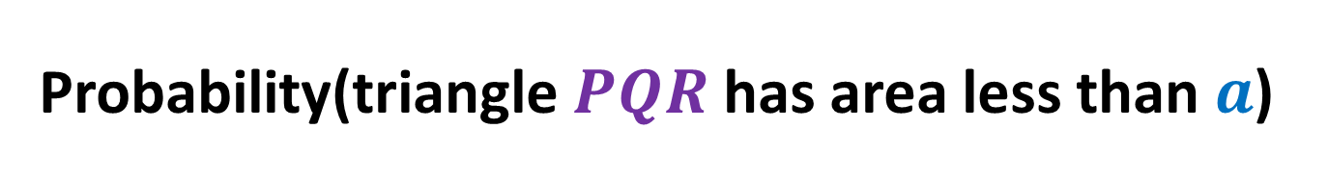



Probability(triangle $PQR$ has area less than $a$)
$$1$$
Question:
Given that $|PQ$| $=r$, what is the prob. that triangle $PQR$ has area $<a$ ?
Answer: less than $\frac{4\sqrt{2} a}{r}$
$$R$$
$$Q$$
$$r$$
$$\frac{2a}{r}$$
$$P$$
$$\frac{2a}{r}$$

Slide 28
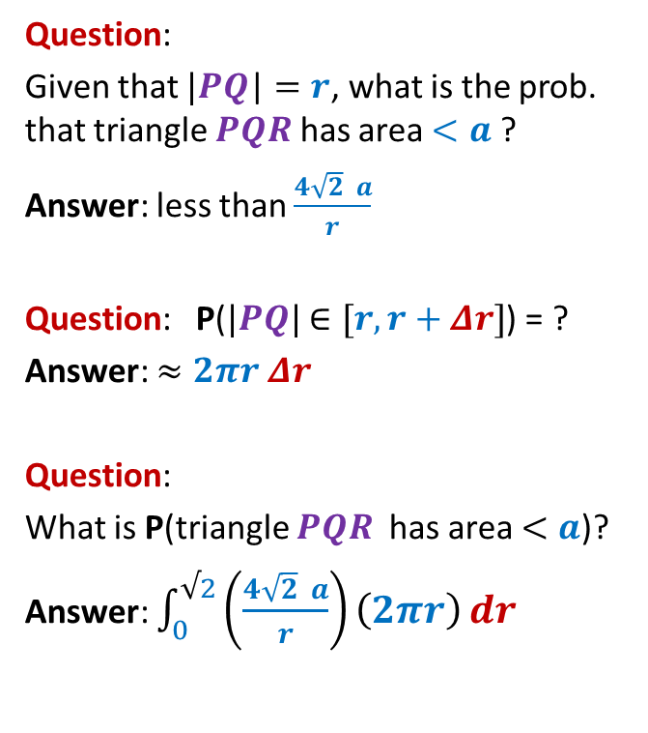




Probability(triangle $PQR$ has area less than $a$)
$$1$$
Question:
Given that $|PQ$| $=r$, what is the prob. that triangle $PQR$ has area $<a$ ?
Answer: less than $\frac{4\sqrt{2} a}{r}$
Question: P($|PQ|$ $∈[r,r+Δr]$) = ?
Answer: $≈2πr Δr$
Question:
What is P(triangle $PQR$ has area $<a$)?
Answer: $\int_{0}^{√2}{\left(\frac{4\sqrt{2} a}{r}\right)\left(2πr\right)}dr$
$$r+Δr$$
$$Q$$
$$r$$
$$P$$
$$=\int_{0}^{√2}{8\sqrt{2} πa}dr$$
$=$ $16πa$

Slide 29

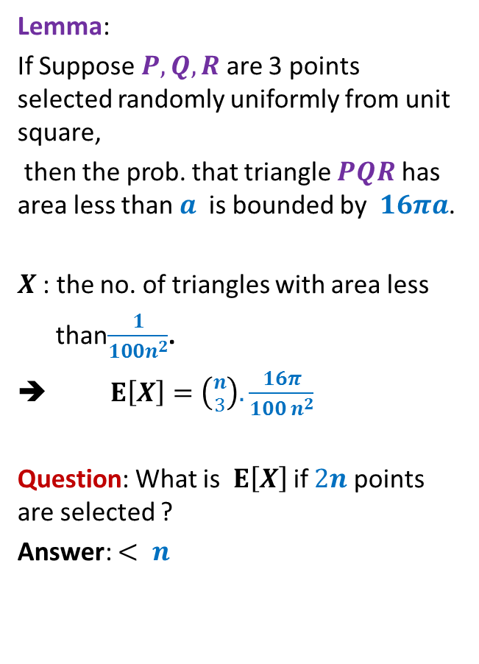
Probability(triangle $PQR$ has area less than $a$)
$$1$$
Lemma:
If Suppose $P,Q,R$ are 3 points selected randomly uniformly from unit square,
then the prob. that triangle $PQR$ has area less than $a$ is bounded by $16πa$.
$X$: the no. of triangles with area less
than$\frac{1}{100n^{2}}$.
➔ $E\left[X\right]=\left({n \atop 3}\right).\frac{16π}{100 n^{2}}$
Question: What is $E\left[X\right]$ if $2n$ points are selected ?
Answer: $< n$
$$R$$
$$Q$$
$$P$$
$$<0.1 n$$

Slide 30
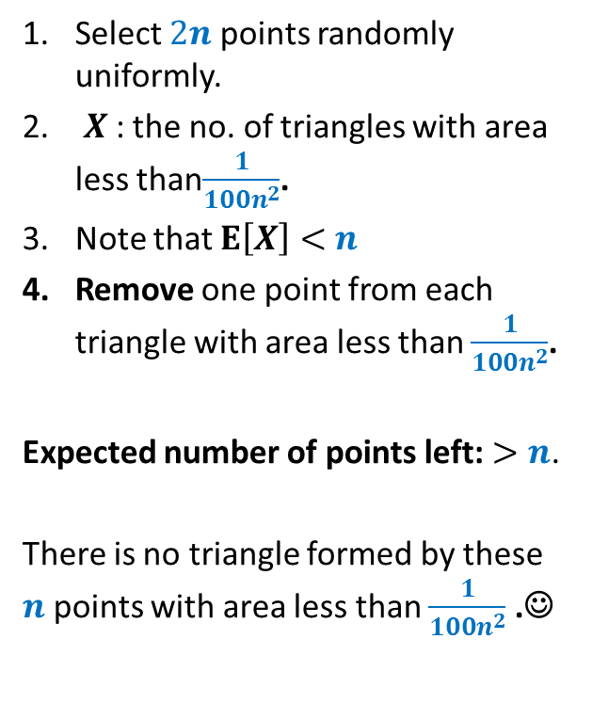
$$1$$
Select $2n$ points randomly uniformly.
$X$: the no. of triangles with area less than$\frac{1}{100n^{2}}$.
Note that $E\left[X\right]<$ $n$
Remove one point from each triangle with area less than $\frac{1}{100n^{2}}$.
Expected number of points left: $>n$.
There is no triangle formed by these $n$points with area less than $\frac{1}{100n^{2}}$ .☺

Slide 31
Alteration
Suppose we wish to show the existence of a structure with desired properties.
The following method is sometimes quite useful
Form a random instance of the structure.
This structure might not have the desired property
but it will be very close to having the desired property.
Slightly alter the random instance and the resulting structure will have the
desired property.

Slide 38
An interesting problem in Graph Theory

Slide 39
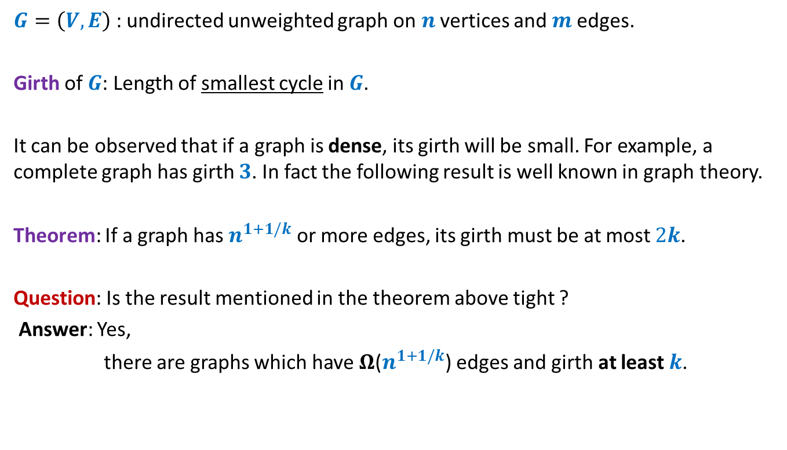
Dense graphs with large girth
$G=\left(V,E\right)$ : undirected unweighted graph on $n$ vertices and $m$edges.
Girth of $G$: Length of smallest cycle in $G$.
It can be observed that if a graph is dense, its girth will be small. For example, a complete graph has girth $3$. In fact the following result is well known in graph theory.
Theorem: If a graph has $n^{1+1/k}$ or more edges, its girth must be at most $2k$.
Question: Is the result mentioned in the theorem above tight ?
Answer: Yes,
there are graphs which have $Ω$($n^{1+1/k}$) edges and girth at least $k$.

Slide 40
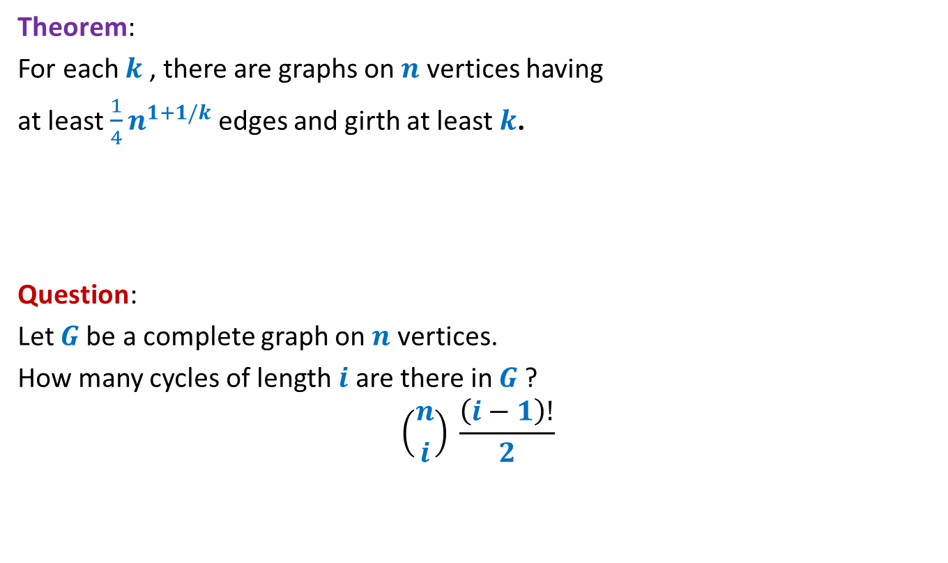
Dense graphs with large girth
Theorem:
For each $k$, there are graphs on $n$ vertices having
at least $\frac{1}{4}n^{1+1/k}$ edges and girth at least $k$.
Question:
Let $G$be a complete graph on $n$ vertices.
How many cycles of length $i$ are there in $G$?
$$\left({n \atop i}\right) \frac{\left(i−1\right)!}{2}$$

Slide 41

Dense graphs with large girth
Theorem:
For each $k$, there are graphs on $n$ vertices having
at least $\frac{1}{4}n^{1+1/k}$ edges and girth at least $k$.
Lemma: A complete graph $G$on $n$ vertices has $\left({n \atop i}\right) \frac{\left(i−1\right)!}{2}$cycles of length $i$ .
Build the desired graph randomly.

Slide 42

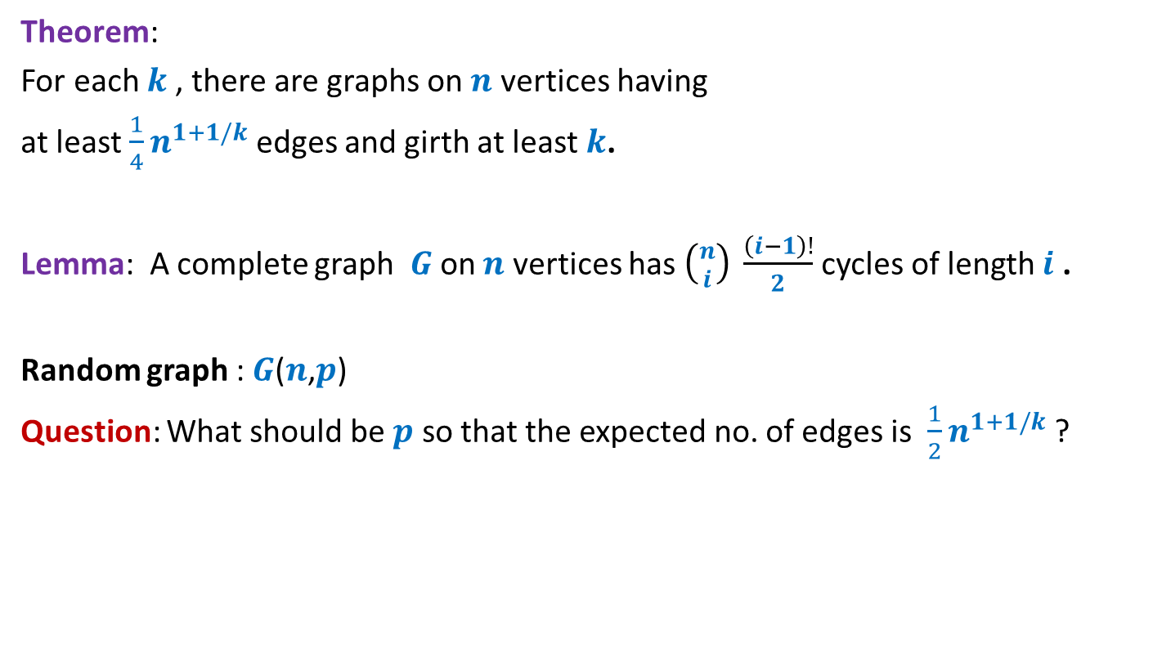
Dense graphs with large girth
Theorem:
For each $k$, there are graphs on $n$ vertices having
at least $\frac{1}{4}n^{1+1/k}$ edges and girth at least $k$.
Lemma: A complete graph $G$on $n$ vertices has $\left({n \atop i}\right) \frac{\left(i−1\right)!}{2}$cycles of length $i$ .
Random graph : $G$($n$,$p$)
Question: What should be $p$ so that the expected no. of edges is $\frac{1}{2}n^{1+1/k}$?
choose $p= n^{\frac{1}{k}−1}$

Slide 43
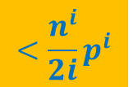
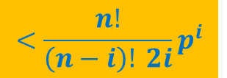
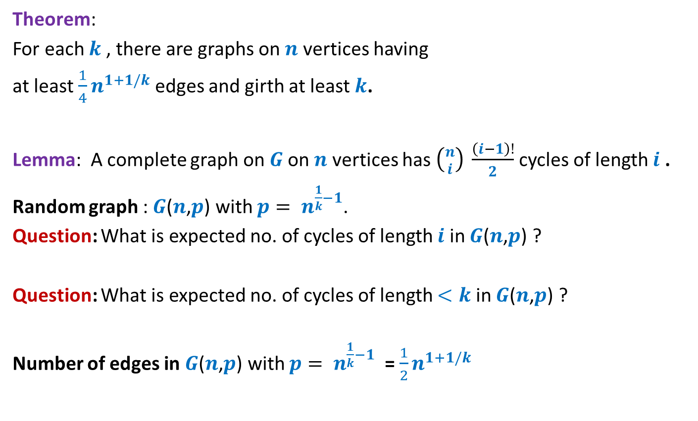


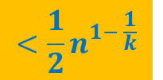
Dense graphs with large girth
Theorem:
For each $k$, there are graphs on $n$ vertices having
at least $\frac{1}{4}n^{1+1/k}$ edges and girth at least $k$.
Lemma: A complete graph on $G$on $n$ vertices has $\left({n \atop i}\right) \frac{\left(i−1\right)!}{2}$cycles of length $i$ .
Random graph : $G$($n$,$p$) with $p= n^{\frac{1}{k}−1}$.
Question: What is expected no. of cycles of length $i$ in $G$($n$,$p$) ?
Question: What is expected no. of cycles of length $<k$ in $G$($n$,$p$) ?
Number of edges in $G$($n$,$p$) with $p= n^{\frac{1}{k}−1}$ = $\frac{1}{2}n^{1+1/k}$
$$<\frac{n^{\frac{i}{k}}}{2i}$$
$$<\frac{n^{i}}{2i}p^{i}$$
$$<\frac{n!}{\left(n−i\right)! 2i}p^{i}$$
$$<\frac{1}{2}n^{1− \frac{1}{k}}$$
Remove one edge from each cycle of length less than $k$.

